Slide 1
Microservices and DevOps
DevOps and Container Technology
Microservices – the short story…
Henrik Bærbak Christensen

Slide 2
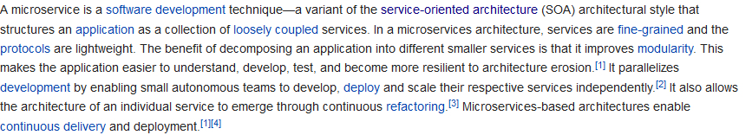
Microservices
The next step? A successful step?
Wikipedia (2018)
Keywords
Loosely coupled, fine-grained, lightweight protocols, autonomous teams, independent deployment and scaling, continuous delivery.

Slide 3
Definition
Newman’s groundbreaking and highly precise definition.
Microservices are small, autonomous services that work together.
Budd (2002)

Slide 4
Defining Characteristics
Small, focused on doing one thing well
Service boundaries are business boundaries
Explicit boundaries (out-of-process communication)
Small enough and no smaller
Autonomous
Separate entity
Communication is network calls (avoid tight coupling) (hm...)
Expose API (technology-agnostic)
Decoupling: can I change this service without changing any other?

Slide 5
Key Benefits
Technological Heterogenity
Each service may use its own technology stack
Pick the right tool for each job
May choose data storage techology independently
Quick technology adaption
Lower risk by selecting new technology for given service
Counterpoint
Overhead in maintaining many technologies
Company ‘Technology Decisions’ may restrict that
NetFlix and Twitter: Only JVM based systems

Slide 6
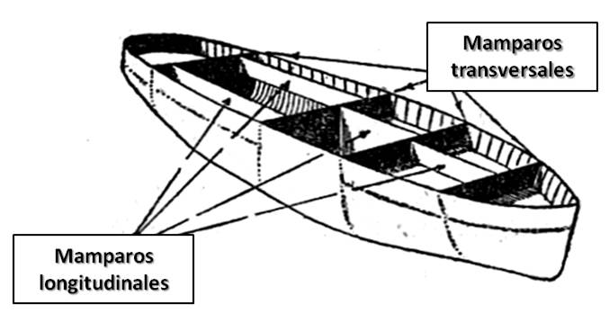
Key Benefits
Resilience
Nygard (2017) pattern: Bulkhead
Bulkhead: Partitioning a system so failures in one part does not lead to system failure
Handle failure of services and degrade functionality accordingly
Counterpoint
Highly distributed systems have a lot of failure modes that needs to be addressed
Will return to Nygard and techniques in next course!

Slide 7
Key Benefits
Scaling
Just scale the microservice that needs scaling
Opposite monolith system: all things scale together
Utilize on-demand provisioning of VMs to scale automatically
Ease of Deployment
A one-line bug fix in one service only means one service to redeploy
And rollback is also much easier
Opposite monolith system: full redeployment of monolith
Fear of breaking stuff => changes accumulate

Slide 8
Key Benefits
Organization Alignment
Small teams on small service – align organization and architecture
Smaller teams on smaller code bases are more efficient
Composability
Functionality consumed in different ways for different purposes
Optimizing for Replacability
Out of date services are easier to replace because its small size
Opposite: That monster COBOL system everybody is afraid of...

Slide 9

Discussion
Actually, I find Fowler has a more precise defintion ☺
Stay tuned – we will return in the second course !!
And the failure mode handling…

